Slide 1
BLMS Vision Statement
Bert Lynn Middle School provides a rigorous curriculum designed to challenge students of all levels and abilities so that today's engaged learners become tomorrow's active leaders; today's diverse learning community becomes tomorrow's global society; and today's caring campus becomes tomorrow's conscientious community. (2009)

Slide 2
College Readiness
College readiness means that graduates have the skills they need to do well in college.
“College” doesn’t just mean a four-year degree. It can mean any program that leads to a degree or certificate.
Being “ready” means that students graduate from high schools with key skills in English and mathematics.

Slide 3
Career Readiness
Career readiness means that high school graduates are qualified for and able to do well in long-term careers.
“Career” doesn’t just mean a job. It means a profession that lets graduates succeed at a job they enjoy and earn a competitive wage.

Slide 4
Why does this matter? Because it’s what our students need
For every 100 ninth graders…
65 graduate from high school
37 enter college
24 are still enrolled in sophomore year
12 graduate with a degree in six years

Slide 5
… and only 6 get a good job after graduation

Slide 6
WHS AP Exams
Participation Rate 42%
Participant Passing Rate 84%
Exams Per Test Taker 3.1
Exam Pass Rate 82%

Slide 7
States that adopted the Common Core

Slide 8
What’s different in the new standards?
English Language Arts/Literacy:
Focus on non-fiction, careful reading
Discuss reading and write using evidence
Increase academic vocabulary
Mathematics
Learn more about fewer concepts
Focus on skill building, speed and accuracy
Use of real world examples to better understand concepts

Slide 9
Our Journey
Mathematics – Engage Learning & New maps
ELA/Literacy (ALL Subjects) –
Working with Essential Questions
Close Reading,
Argumentative Writing,
Emphasis on inquiry and discussion between students (dialectical methods)

Slide 10
Great teachers
Picture in your mind a great teacher in your life… (Share with someone near you name and why they were great.)
The mediocre teacher tells.
The good teacher explains.
The superior teacher demonstrates.
The great teacher inspires.
(William Arthur Ward)

Slide 11
Engaged Students
Traditional Mathematics vs. Common Core
What do “Engaged Students Look Like?”
Essential Questions
What is the most common answer to “What did you do today?”

Slide 12
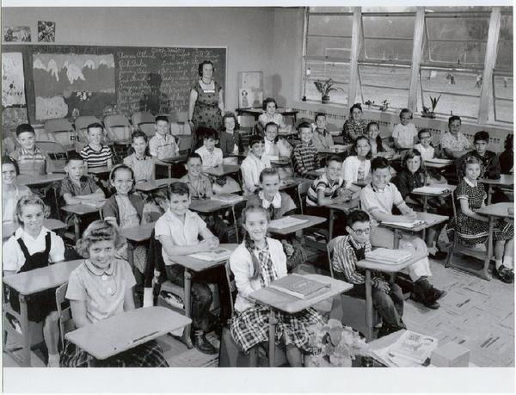
Engaged Students
Traditional Mathematics vs. Common Core
What do “Engaged Students Look Like?”
Essential Questions
What is the most common answer to “What did you do today?”

Slide 13
BLMS Engaged

Slide 14
Depth of Knowledge (1997)
DOK 1 - Recall elements and details of story
DOK 2 – Skills Concepts
DOK 3 - Strategic Thinking
DOK 4 – Extended Thinking

Slide 15
Depth of Knowledge (1997)

Slide 16
Complexity of Task

Slide 17
Types of Writing
Grade | Argumentative | Explain | Narratives
4 | 30% | 35% | 35%
8 | 35% | 35% | 30%
12 | 40% | 40% | 20%

Slide 18
Backpacks: What you should see
Real-world examples that makes what they’re learning in English and math make more sense
Books that are both fiction and non-fiction
Writing assignments that require students to use evidence instead of opinion
Math homework that asks students to write out how they got their answer
Math homework that ask students to use different methods to solve the same problem

Slide 19
Some questions to ask your child
How did you use evidence in school today? Where did you get it?
Did you talk about anything you read in class today? Did you use evidence when you talked about what you read?
How often did you use math today? How did you use it?
Did you learn any new words in class today? What do they mean? How do you spell them?

Slide 20
Break Outs
ELA
Math

Slide 21
Shifts in Mathematics
Shift 1: Focus
Shift 2: Coherence
Shift 3: Fluency
Shift 4: Deep Understanding
Shift 5: Application
Shift 6: Dual Intensity

Slide 22
Shifts in ELA/Literacy
Shift 1 Balancing Informational & Literary Text
Shift 2 Knowledge in the Disciplines
Shift 3 Staircase of Complexity
Shift 4 Text-based Answers
Shift 5 Writing from Sources
Shift 6 Academic Vocabulary

